Slide 1

LIP LENSE
WEEK#4:
Exploratory Data Analysis

Slide 2
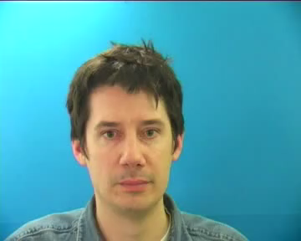
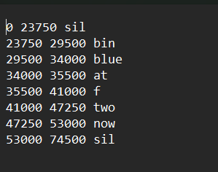
EDA- Overview
Video Data:
Annotations (text):

Slide 3






Video Data – Meta Data
1000 Video Files (S1)
~ 0.41MB Storage size
288 X 360 Resolution
25 Frames per sec
~ 74.9 Total Frame Count
~ 2.9 Secs (Duration)

Slide 4
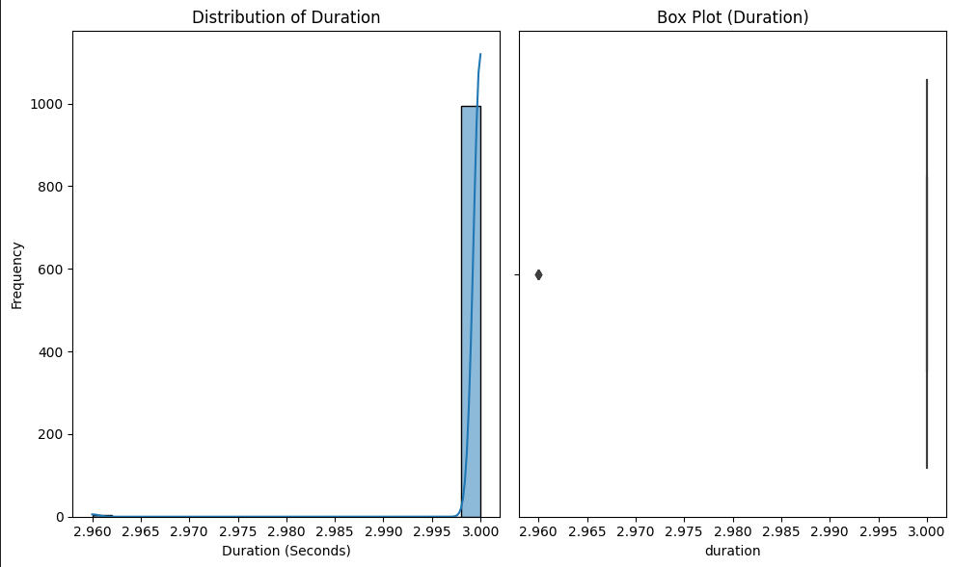
Data Consistency
Duration was pretty consistent around the dataset, suggesting that there is little variation pertaining to one speaker (S1).

Slide 5
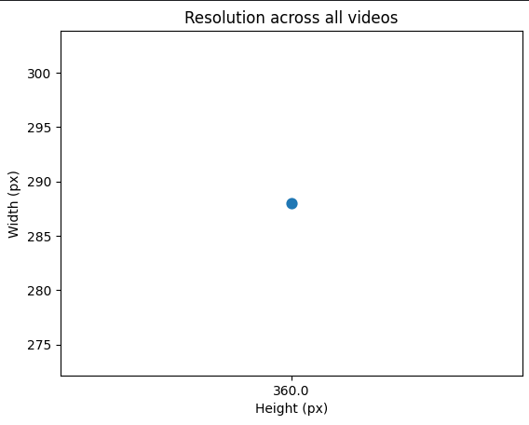
Data Consistency
Videos showed consistency around resolution (HXW).

Slide 7
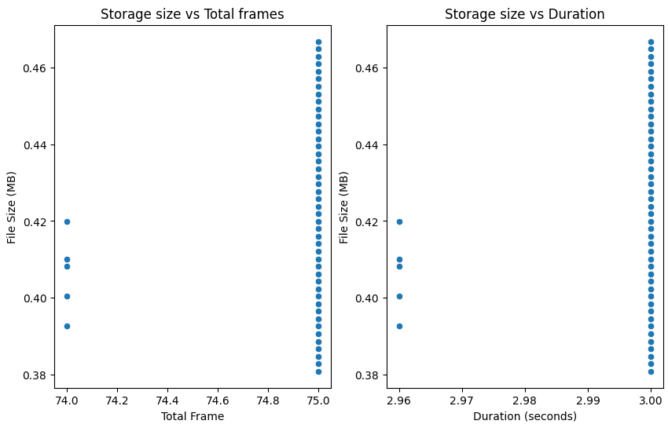
Data Consistency
Storage size displayed some variation between (<0.40MB to >0.46MB)

Slide 8
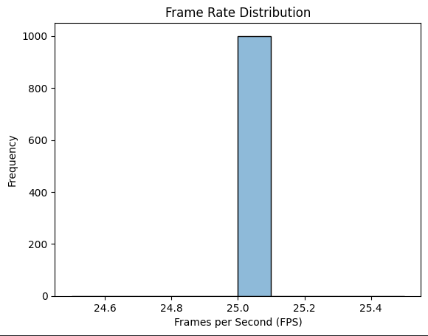
Data Consistency
Consistent frame rate ensures consistent temporal information, which is crucial for model training.

Slide 9
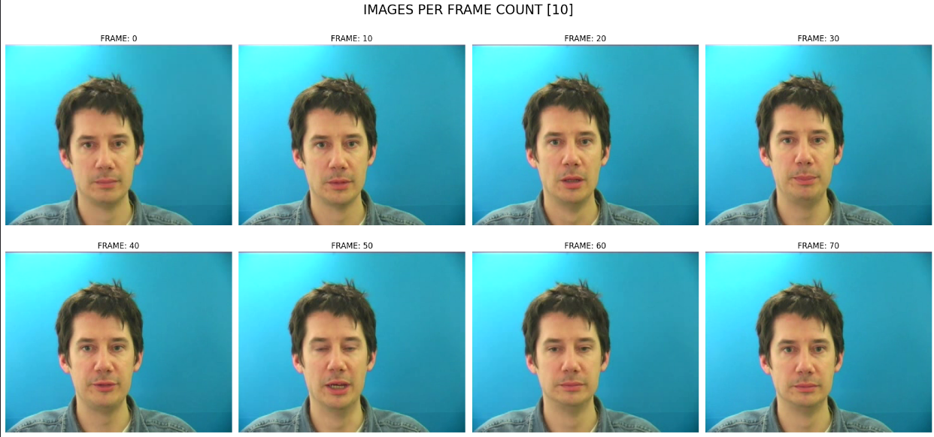
FRAMES [10]:

Slide 10
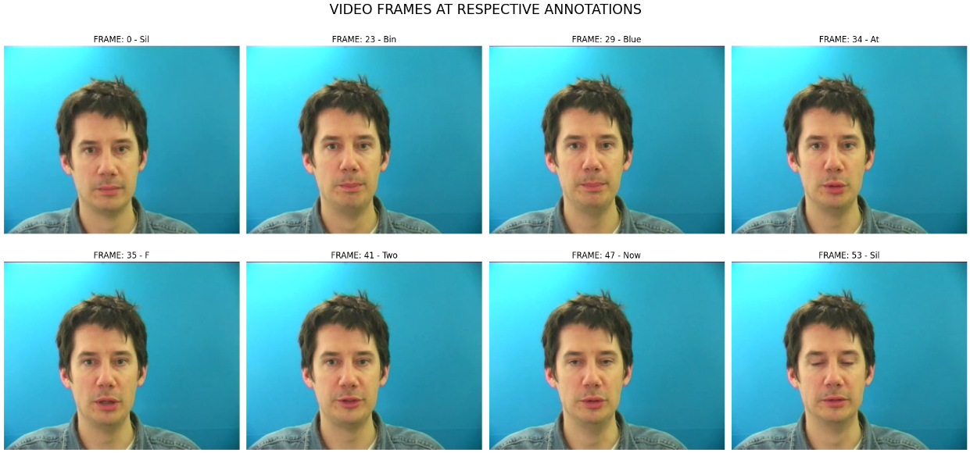
FRAMES [ANNOTATIONS]:

Slide 11
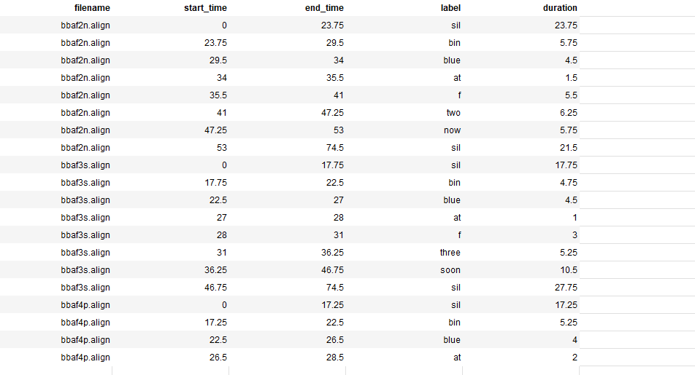
Overview of the annotations

Slide 12
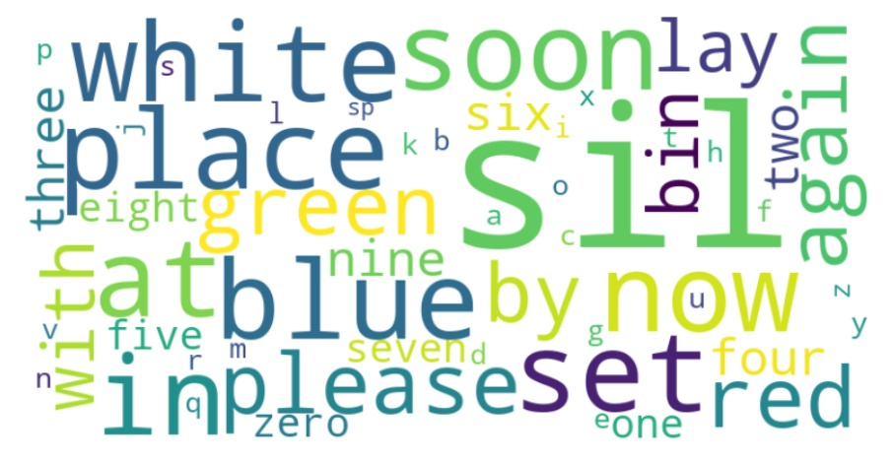
Annotated text word cloud

Slide 13
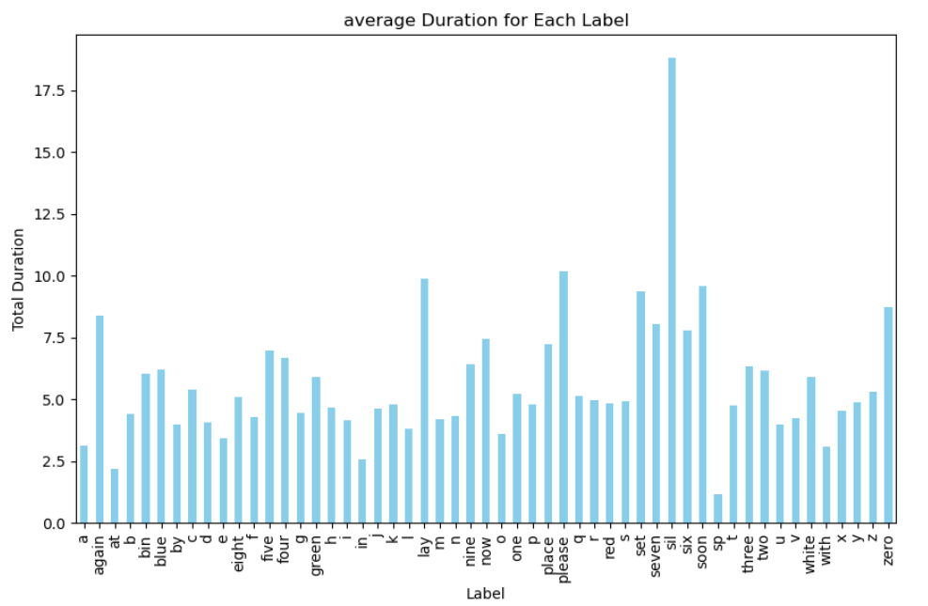
Average duration for each annotated text

